Slide 1
E-commerce Backend System
Using FastAPI
By- Ashish Dode

Slide 2
Project Overview
The project is a backend system for an e-commerce platform.
Built using FastAPI, focusing on clean architecture and modular design.
Supports admin product management, user authentication, cart management, checkout, and order tracking.
APIs are secured using JWT .
Tested using Postman and Swagger.

Slide 3
Technology Stack:
FastAPI
PostgreSQL
SQLAlchemy
Alembic
Pydantic
JWT
SMTP

Slide 4
System Architecture
Modular folder structure:
auth/: Handles authentication and authorization.
products/: Admin and public product APIs.
cart/: Shopping cart endpoints.
checkout/: Dummy payment and order creation.
orders/: Order tracking.
core/: Shared configs and database connection.
utils/: Email service and helper functions.

Slide 5
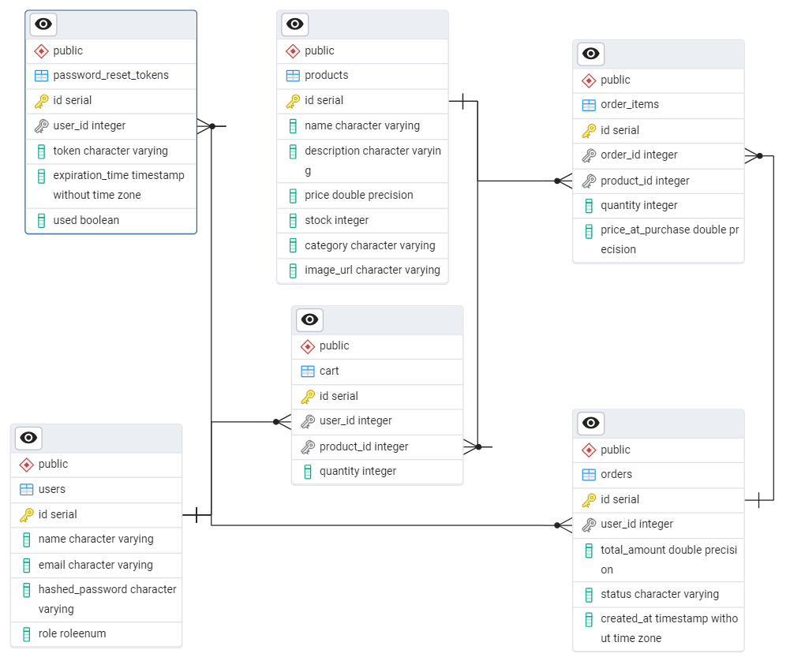
Database Schema
users: Contains all registered user's detail.
products: Stores all product-related data.
cart: Temporary table storing products added by users for checkout.
password_reset_tokens: Stores reset token details for password recovery.
orders: Holds finalized order records.
order_items: Line items for each order. Tracks product quantity and price at the time of purchase.

Slide 6
Authentication & Authorization
Signup: New users can register with email, password, role.
Signin: Users receive JWT access token.
RBAC: Admins manage products, users can browse and purchase.
JWT: Access token includes user ID and role.
Password Security: Bcrypt used to hash passwords.
Forgot/Reset Password: Token-based reset via email.

Slide 7
product Management (Admin)
Create Product: Add new product.
Read Products: List and get product details.
Update Product: Modify existing products.
Delete Product: Remove outdated items.

Slide 8
Public Product APIs
Product Listing: Paginated with filters for price, category.
Search: Query by keyword.
Details: View individual product.
Accessible to all (no login required).

Slide 9
Cart Management
Add to Cart: Authenticated users can add products.
View Cart: Check current cart contents.
Update Quantity: Change quantity per item.
Remove Item: Delete specific product from cart.

Slide 10
Checkout Process
Dummy Checkout: Mocks payment process.
Order Creation: Cart items are converted to an order.
Cart Clearance: Cart emptied post-checkout.
Order Record: Tracks total amount, products, status.

Slide 11
Orders & history
Order History: View list of past purchases.
Order Details: Each order shows items, quantity, price.

Slide 12
Conclusion
Successfully designed and developed a secure e-commerce backend using FastAPI.
Implemented key features such as JWT authentication, RBAC, CRUD operations, cart management, checkout, and order history.
Integrated email functionality (SMTP) for password recovery to enhance real-world usability.
Maintained clean modular architecture for better readability, testing, and future scalability.

Slide 13
Thank you

